Slide 1
Contrastive Language-Image Pre-Training
CLIP
Learning Transferable Visual Models From Natural Language Supervision, Radford, Kim, Hallacy and others, Feb 2021
Florian Bordes
Gaston Tentillier
Paul Fotso Kaptuez
MAP 583

Slide 2
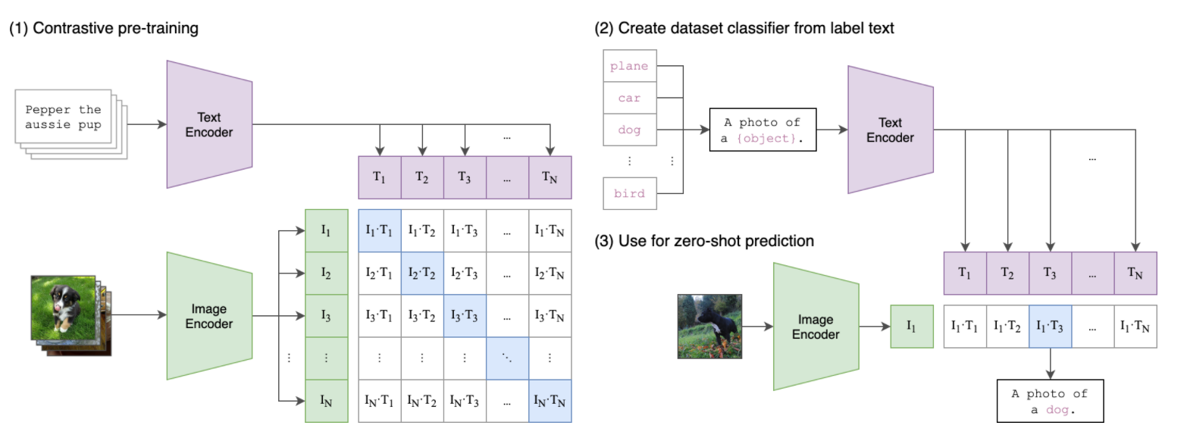
General approach of CLIP

Slide 3
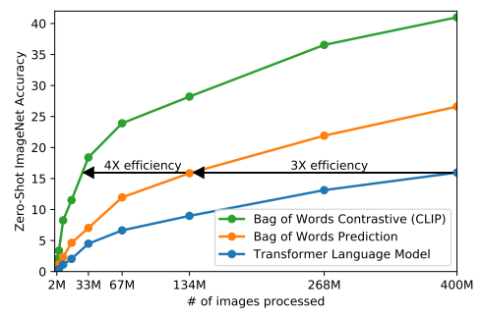
CLIP Training method
Not a predictive but a contrastive objective : task of predicting which text is paired as a whole with an image and not the exact words.
=> very efficient at zero-shot transfer (gain in accuracy)
New dataset of 400 million (image, text) pairs collected from various sources on the Internet

Slide 4
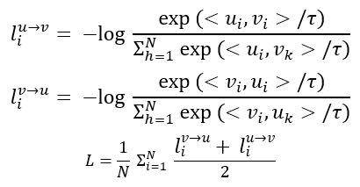
CLIP Training method
Only data augmentation : random square crop from resized images
Learning of a multi-modal embedding space
Model : Resnet50 for the Image encoder and a text transformer for the Text encoder
Cross-Entropy Loss

Slide 5
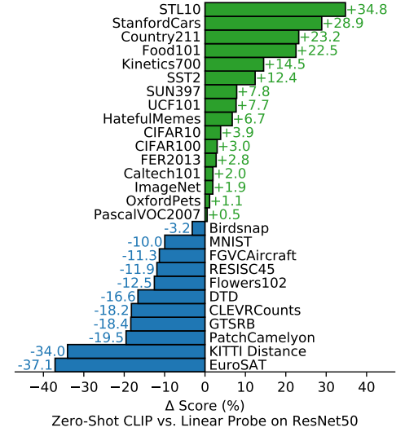
Zero-shot CLIP Performance
Comparison with a fully supervised classifier fitted on Resnet-50 :
- outperforms on 16 upon 27 datasets especially on general object classification datasets such as ImageNet
- poor capabilities on complex tasks (traffic sign recognition GTRSB or satellite image recognition EuroSAT)
- more relevant with few-short prediction

Slide 6
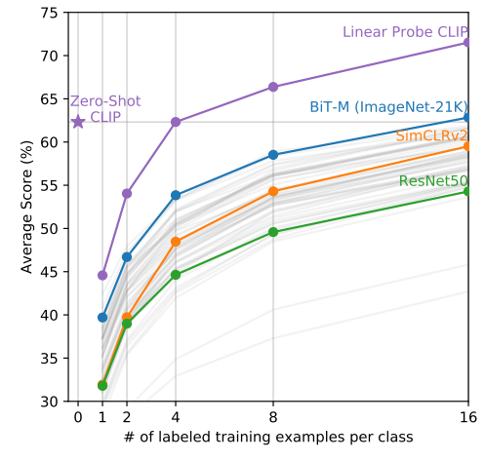
Zero-shot CLIP Performance
Outperforms few-shot linear probes
Zero-shot doesn't underperform one-shot !
Matches the best results of a 16-shot linear classifier across publicly available models

Slide 7
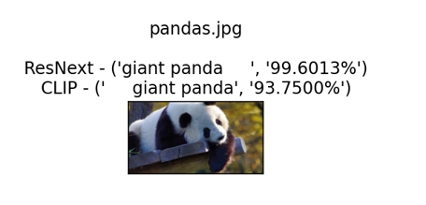
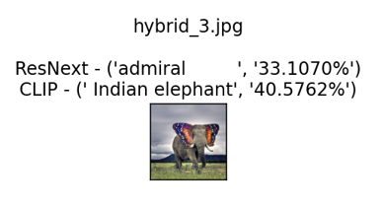
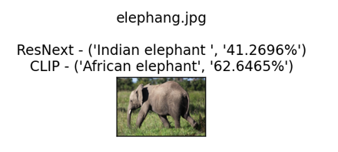
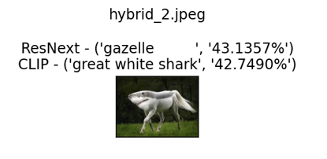
Zero-shot CLIP vs Resnext
Resnext => enhancement of Resnet
Interesting results especially on hybrids

Slide 8
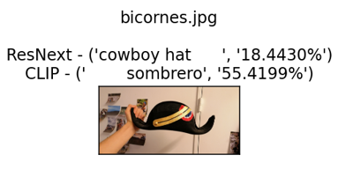
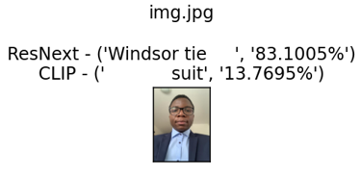
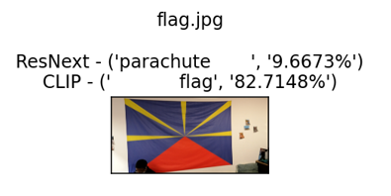
Zero-shot CLIP vs Resnext on personal images

Slide 9
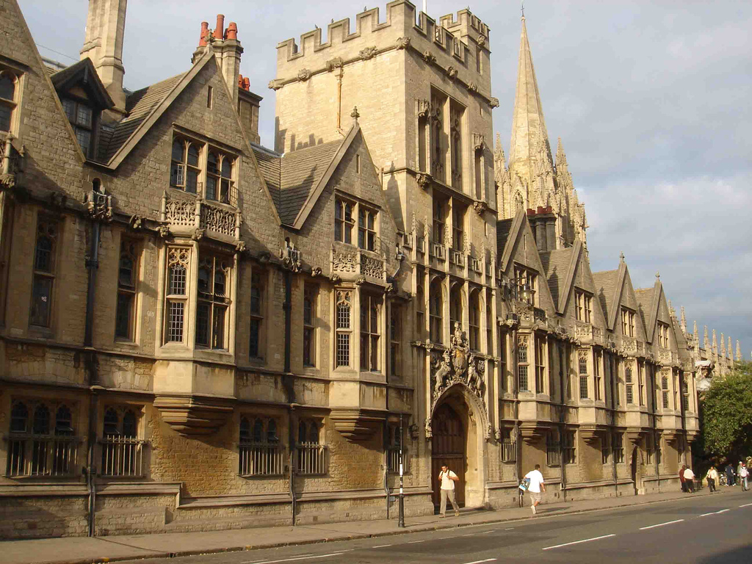
Zero-shot CLIP Performance
Test over Oxford buildings dataset
Cleaning of the dataset
Dual analysis of the photos:
- Quality
- Building
Accuracy for quality and building: 14,6%
Accuracy for building only: 16,7%

